Slide 1
DIVIDE AND CONQUER

Slide 2
What is convex hull problem?
A convex hull is the smallest convex polygon that completely encloses a set of points in a two-dimensional or three-dimensional space.
It can be thought of as the "envelope" or "wrapper" of the points.
We use the divide and conquer approach to solve this by recursively calling the function for smaller parameters.
Here is an illustration of our approach:

Slide 3
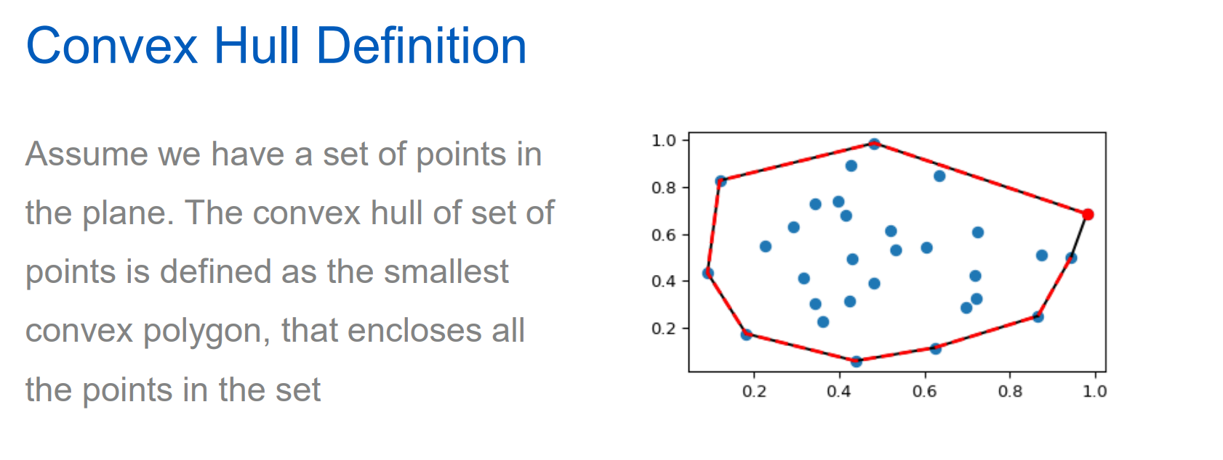

Slide 4
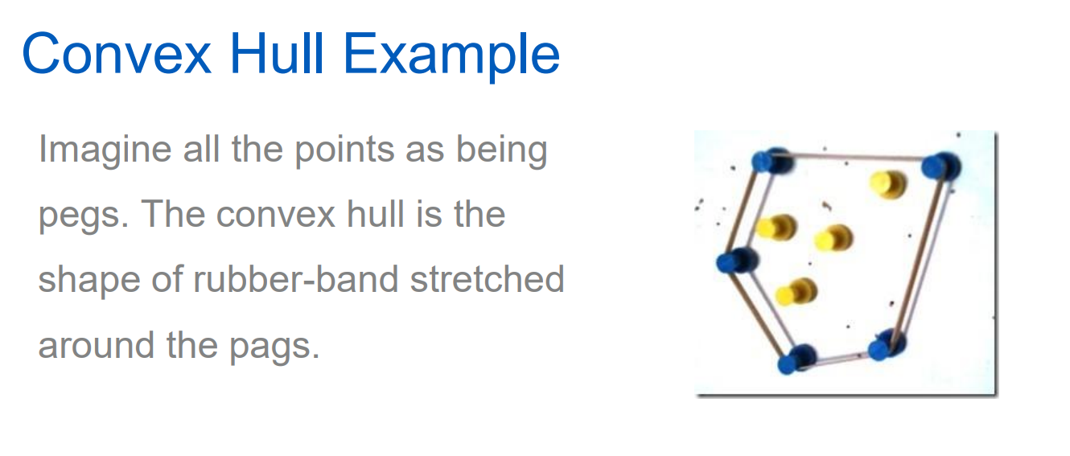

Slide 5
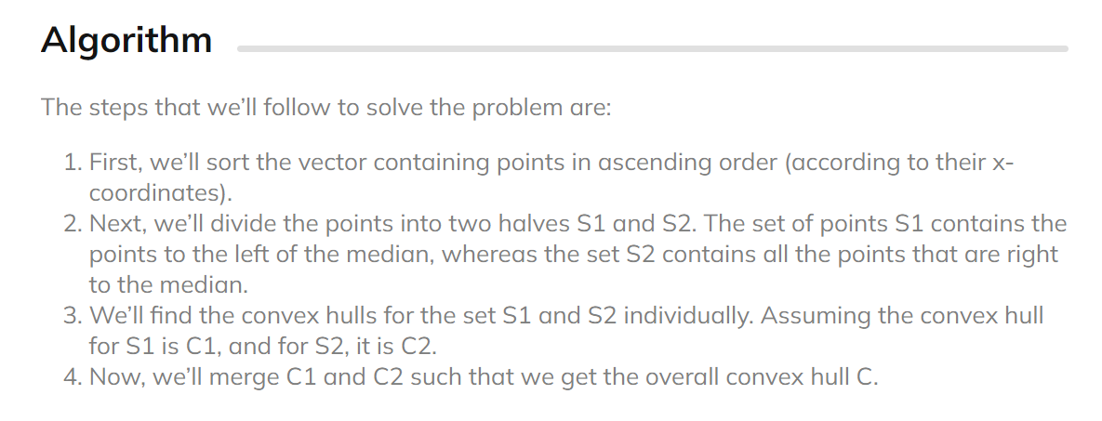

Slide 6
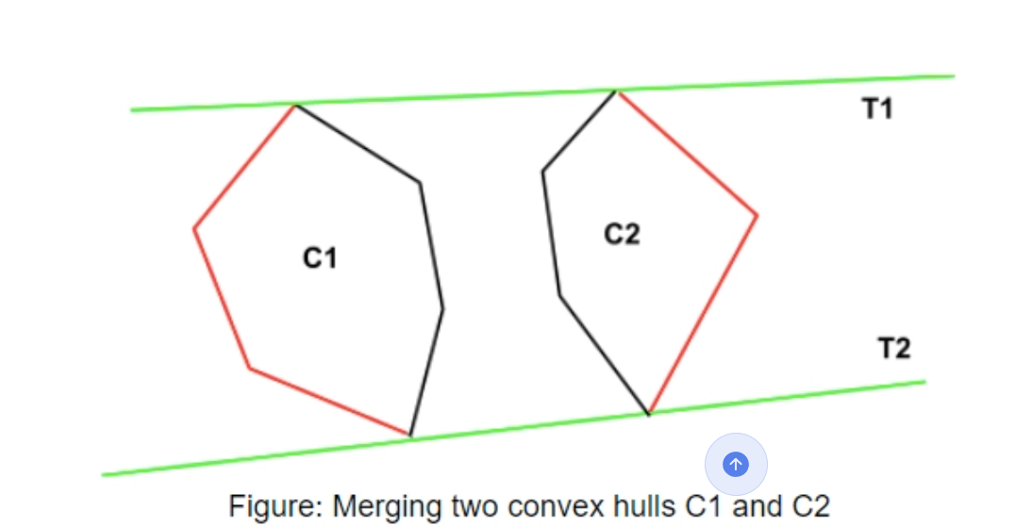
MERGING OF TWO CONVEX HULLS

Slide 7
Finding the upper tangent and lower tangent.
For finding the upper tangent, we start by taking two points.
The rightmost point of a and leftmost point of b.
The line joining them is labelled as 1.
As this line passes through the polygon b (is not above polygon b) so we take the anti-clockwise next point on b, the line is labelled 2.
Now the line is above the polygon b. But the line is crossing the polygon a, so we move to the clockwise next point, labelled as 3 in the picture.
This again crossing the polygon a so we move to line 4. This line is crossing b so we move to line 5. Now this line is crossing neither of the points.
So this is the upper tangent for the given polygons.

Slide 8
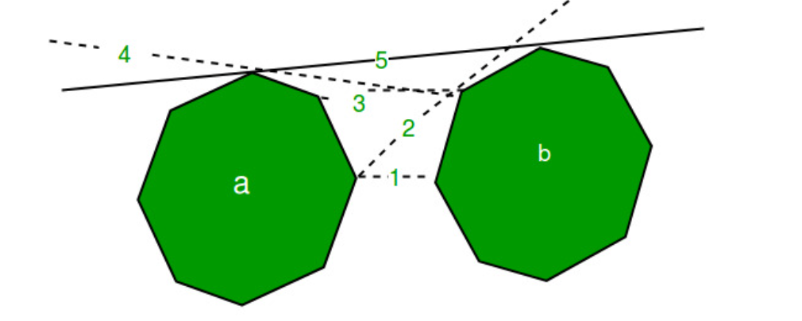

Slide 9
For finding the lower tangent we need to move inversely through the polygons
If the line is crossing the polygon b we move to clockwise next and to anti-clockwise next if the line is crossing the polygon a.

Slide 10
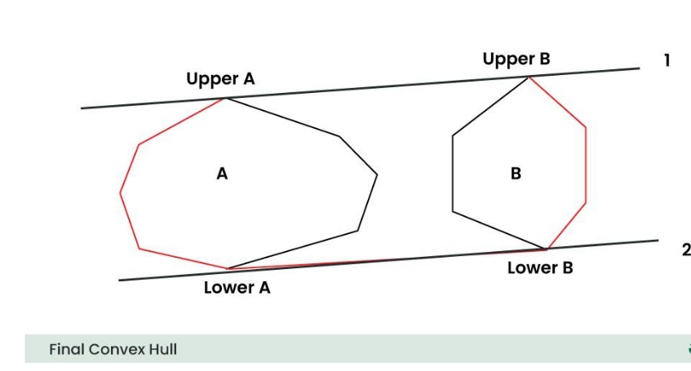
Final Convex Hull

Slide 11
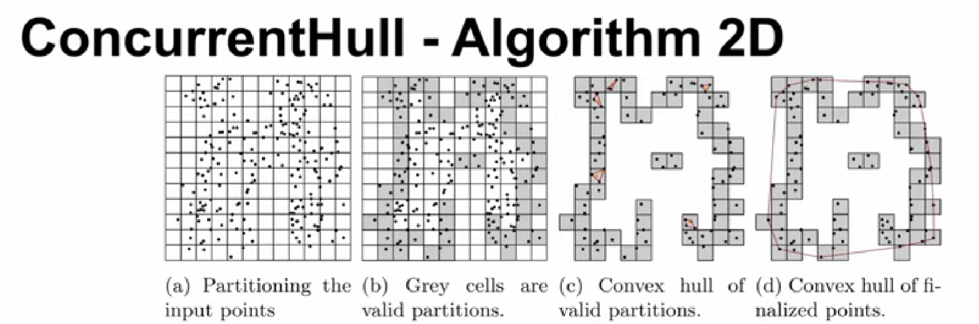

Slide 12
